Slide 1

Sustainable Feasibility Analysis between EVs and ICEVs in Vancouver
Group 16 : ALEENA MARY GEORGE 30221225
IRENE SHAJAN 30220382
MONJURUL HAQUE 30261730
G.K. MD. MUTTAKIN 30246286
AHMED MASHOOK IQBAL 30267500

Slide 2
CONTENTS
Introduction
Importance of Comparing ICEVs and EVs
Social, Economic, and Environmental Issues (The Do-Nothing Scenario)
Analysis from Stakeholders’ Perspective
Existing Solution for Sustainable Transportation
The Proposed Alternative for Measuring Sustainability
Sustainability Impact Factors
Set of scores measuring sustainability impact for the EV system.
Impact of the Sustainable Alternative on the Stakeholders
Positive and Negative Disruptions of EV Adoption
Measurement of Indicators
Benchmarking Performance Indicators
Conclusion

Slide 3

INTRODUCTION
Importance of Sustainability: Ensures ecological balance, social equity, and economic prosperity.
Transportation Sector Impact:
Major contributor to global GHG emissions, especially ICE vehicles.
Accounts for 22% of Canada’s emissions .
In Metro Vancouver: 35% of emissions from fossil fuel-powered vehicles.
Electric Vehicles (EVs) as a Solution:
Reduce GHG emissions and energy consumption.
Optimize life-cycle costs and infrastructure use.
Study Focus:
Comparative analysis of EVs vs. ICE vehicles in Vancouver.
Factors: Emissions, energy, infrastructure, and societal impacts.
Goal: Provide recommendations for sustainable urban transportation.

Slide 4
Importance of Comparing ICEVs and EVs
Vancouver’s Leadership in Sustainability:
Committed to reducing GHG emissions through policy activism.
Transportation sector: ~40% of area’s emissions.
Transition to clean energy as a key step toward GHG reduction.
EVs v/s ICEVs:
EV Advantages:
Powered by B.C.’s hydroelectricity, enabling cleaner energy use.
Lower emissions: Minimal CO₂ and air pollutants.
ICEV Disadvantages:
Significant CO₂ and nitrogen oxide emissions.
Health impacts: Chronic respiratory and cardiovascular issues.
Supporting Policies:
Climate Emergency Action Plan: Net-zero carbon by 2050.
ZEV Act & CleanBC Go Electric Program: Subsidies and EV charging infrastructure.
Impact of Transition:
Reduced emissions and carbon footprint and enhanced public health and quality of life.
Positioning Vancouver as a leader in sustainable urban mobility.

Slide 5
Social, Economic, and Environmental Issues (The Do-Nothing Scenario)
Social Impacts:
-Respiratory and cardiovascular diseases caused by vehicle pollution.
-Traffic noise increases stress in urban areas and traffic congestion reduces time, causing frustration.
-Low-income families rely on older, inefficient vehicles, worsening financial and health burdens.
-Limited public awareness and access to cleaner, affordable alternatives.
Economic Impacts:
-Rising fuel costs make transportation less affordable and frequent vehicle maintenance adds to household expenses.
-Carbon taxes increase the cost of driving gas-powered vehicles.
-Cities spend heavily on roads and gas stations, delaying investments in greener options.
-Traffic delays impact business productivity and worker efficiency.
Environmental Impacts:
-Greenhouse gases harm the planet and future generations and its emissions degrade air quality and harm wildlife.
-Fossil fuel extraction damages ecosystems and causes habitat loss.
-Roads and parking lots consume land that could be used for parks or housing.
-ICEV reliance hinders Vancouver’s green city goals and climate change mitigation.

Slide 6
Analysis from Stakeholders’ Perspective
City of Vancouver, Province of British Columbia, Federal Government, Neighboring Municipalities
Transportation’s contribution - GHG emissions and Economic reliance - fossil fuels.
Challenges in achieving CleanBC climate action goals and regulating the ICE industry.
Translink
High GHG emission from ICE vehicle
Vancouver Coastal Health
Public health impacts from air and noise pollution.
Increased healthcare costs and reduced resident quality of life.
Rising fuel costs- barriers to achieving sustainability goals.
Limited access to affordable sustainable transportation
Residents & Commuters
High fuel and maintenance cost
Resistance from traditional ICE owners to transition.
Businesses & Industry
Rising delivery costs due to ICE reliance
ICBC(Insurance Corporation of BC)
High claims from ICE vehicle accidents and rising premiums - fossil fuel vehicles.
Pressure – promote cleaner alternatives. and resistance - traditional car owners
Automotive Manufacturers
Decreasing demand- ICE vehicles and pressure to comply - emission standards
Need for R&D investment in zero-emission technologies and declining ICE market share.

Slide 7

Existing Solution for Sustainable Transportation
Enhanced EV Charging Infrastructure
Installation of EV charging stations in:Parking lots, Commercial districts, City streets.
Incentives via CleanBC Go Electric Program: Rebates for home charging stations
and subsidies reducing upfront EV costs.
EV-Friendly Regulations and Development
New construction mandates include EV charging infrastructure.
Supportive policies encourage EV adoption.
Promoting Sustainable Transportation
Introduction of "Mobility Hubs": Combine EV charging, bike-share programs, and
transit stops and facilitate a shift to cycling, walking, and public transportation.
Carbon Taxes as Motivation
Increased cost of carbon emissions encourages cleaner transportation.
Incentivizes families to choose EVs over gas-powered vehicles.
Public Education Initiatives
Campaigns dispel myths about EVs and highlight their benefits.
Simplifies the transition for hesitant drivers.

Slide 8


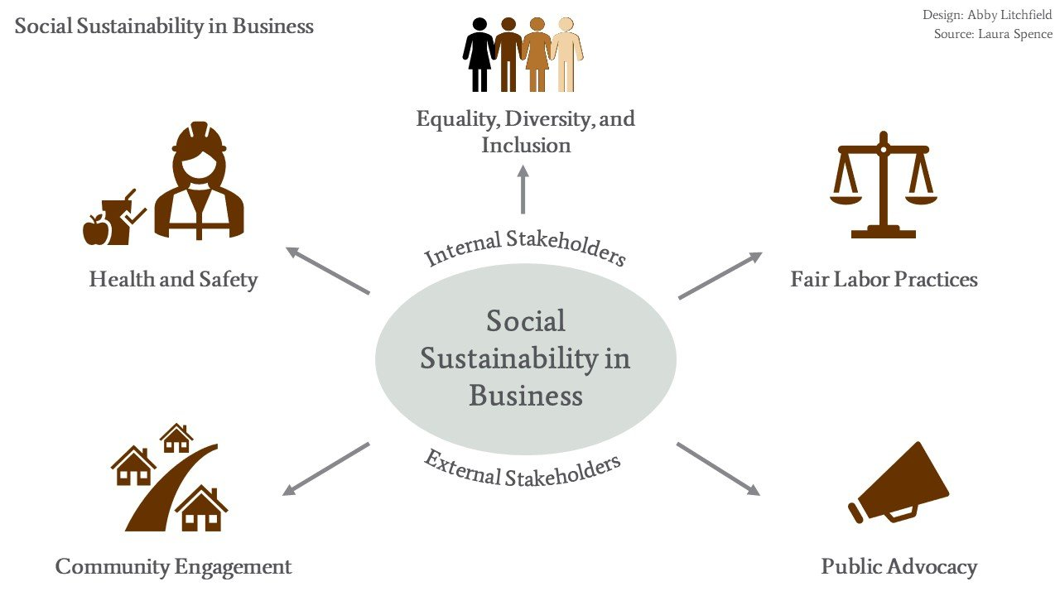
Proposed Alternative for Measuring Sustainability
Key Sustainability Goals:
Environmental
Economic
Social

Slide 9
Economic
Personal Mobility for Ev's
Commute Travel Time and Reliability
Charging Station Density
Vehicle and Infrastructure Costs
Social
Affordability of EV's
Equitable Access to EVs
Public Satisfaction with EV Infrastructure
Environmental
Energy Consumption per Capita
Air Pollution Emissions Reduction
Greenhouse Gas Emissions
Noise Pollution Reduction
Sustainability Impact Factors

Slide 10
Environmental Indicators
Greenhouse Gas Emissions: Lower CO₂ emissions = Better.
Air Pollution Emissions: Reduced PM, NOx, SOx = Better.
Battery Production Impact: Minimize emissions/resource use = Better.
Renewable Energy Usage: Higher % of EVs powered by renewables = Better.
Noise Pollution Reduction: Decrease noise generated by EVs = Better.
Social Indicators
Affordability: Lower household budget spent on EVs = Better.
Transport Diversity: Wider variety of EV options (cars, buses, bikes) = Better.
Traffic Congestion: Reduced congestion = Better.
User Satisfaction: Higher satisfaction among EV users = Better.
Traffic Safety: Fewer crashes and fatalities involving EVs = Better.
Economic Indicators
Charging Station Density: Increased station availability = Better.
Commute Travel Time: Reduced commute times = Better.
Legitimatized Environmental Impact: Lower economic cost of emissions = Better.
Disposable Income & Savings: Increased savings from lower EV operating costs = Better.
Vehicle & Infrastructure Costs: Lower costs for ownership, infrastructure, and maintenance = Better.
Set of scores measuring sustainability impact for the EV system.

Slide 11

Impact of the Sustainable Alternative on the Stakeholders
Stakeholders
Consumers and EV Drivers
Government and Policymakers
Local Communities
Utility and Energy Providers
Environmental Organizations

Slide 12
Positive and Negative Disruptions of EV Adoption:
Positive Disruptions:
Negative Disruptions:
Enviromental perspective
Reduction in greenhouse gas (GHG) emissions.
Decrease in local air and noise pollution.
Reduction in soil and water contamination.
Mitigation of global climate change.
Improved public health.
Promotion of sustainable urban lifestyles.
Enhanced quality of life and city aesthetics.
Greater mobility and accessibility.
Growth in industries.
Increased demand for skilled labor.
Revenue growth from government investments.
Economic boost from EV tourism tied to green branding.
Temporary emissions increase during implementation phase
Environmental challenges from mining materials for EV batteries.
Recycling and disposal issues related to EV batteries.
Temporary disruptions during EV infrastructure construction.
Adjustment challenges for workers.
Accessibility gaps in underserved areas.
Short-term financial burdens for governments.
High upfront costs for consumers.
Affordability challenges.
Social perspective
Economic perspective

Slide 13
Measurement of Indicators
1.Environmental and Energy Indicators
CO2 Emissions:
EVs: Decline from 1,000 tons (2022) to 300 tons (2050).
CVs: Increase from 15,000 tons (2022) to 25,000 tons (2050).
Air Pollutants:
EVs: Negligible NO₂ and PM emissions by 2050.
CVs: Rising NO₂ (75 tons/year) and PM emissions by 2050.
Energy Consumption:
EVs: Modest growth from 180,000 MWh (2022) to 240,000 MWh (2050).
CVs: Sharp rise from 300,000 MWh (2022) to 450,000 MWh (2050).
Efficiency:
EVs: Improved from 0.2 kWh/km to 0.15 kWh/km by 2050.
CVs: Reduced fuel efficiency, from 10L/100km (2022) to 7L/100km (2050).

Slide 14
2. Economic and Social Indicators
Economic Benefits:
-Cost savings from prevented emissions: $1.4M (2022) → $2.8M (2050).
-EV-related jobs: Growth from 40,000 (2022) to 70,000 (2050).
-Decline in CV-related employment and infrastructure investments.
Social Advancements:
-EV affordability improves by 2030, accessible to most by 2050.
-Increased transport diversity with EV dominance in public and private sectors.
-Traffic safety: Lower accident rates with autonomous EV technologies.
-Noise pollution: Significant reduction; near-zero by 2050.
Notes:
Economic Indicators:
Charging Station Density: This metric measures the availability of EV charging stations per unit area. More stations mean easier access and reduced anxiety for EV users.
Commute Travel Time: With reduced traffic congestion and optimized infrastructure, commute times are expected to decrease for EV users.
Vehicle and Infrastructure Costs: EVs are expected to become more affordable over time due to advances in battery technology and economies of scale.
Social Indicators:
Affordability: Policies like subsidies and rebates can make EVs more accessible to a larger segment of the population.
User Satisfaction: Surveys show that EV users report higher satisfaction due to lower maintenance costs and improved driving experience.
Traffic Safety: EV adoption is linked to reduced traffic accidents due to quieter operations and advancements in autonomous driving technologies.

Slide 15
Environmental Benefits:
GHG Emissions
Energy Consumption
Air Pollution
Battery Lifecycle
Social Impacts:
Public Health
Infrastructure Development
Behavioral Adaptation
Quality of Life
Economic Impacts:
Cost of Ownership
Fuel Costs
Job Market
Energy Security
Benchmarking Performance Indicators
Notes:
Benchmarking allows us to compare the current and projected performance of EVs and ICEVs under various scenarios. Let’s highlight some key metrics:
Greenhouse Gas Emissions:
In the current scenario, ICEVs emit around 15,000 tons of CO₂ annually, compared to 1,000 tons for EVs. By 2050, with 50% EV adoption, emissions could fall to 300 tons for EVs while ICEV emissions rise to 25,000 tons.
Energy Efficiency:
EVs are far more energy-efficient, consuming just 0.2 kWh/km compared to ICEVs, which require 10 liters of fuel per 100 km. This difference underscores the energy savings potential of EVs.
Economic Benefits:
The total cost of ownership for EVs is projected to become lower than ICEVs by 2030 due to declining battery costs and reduced fuel and maintenance expenses.
Job creation in green sectors, including EV manufacturing and infrastructure development, is expected to increase significantly.
Public Health and Quality of Life:
EV adoption will lead to cleaner air and quieter streets, contributing to a healthier and more livable urban environment. By 2050, EVs could help reduce respiratory diseases linked to air pollution by up to 30%.

Slide 16
CONCLUSIONS
Sustainability of EVs in British Columbia
Key Benefits:
Lower GHG emissions and improved air quality.
Long-term cost savings and job creation in green sectors.
Enhanced public health and quality of life.
Alignment with Goals:
Supports net-zero emissions and energy efficiency targets.
Call to Action:
Invest in EV infrastructure and incentives to lead in sustainable transportation.
Notes:
*"In conclusion, our analysis shows that transitioning to EVs is not just a technical or environmental decision—it is a necessity for the sustainable future of Vancouver.
Environmentally, EVs offer near-zero emissions, drastically reduced air and noise pollution, and lower energy consumption.
Socially, they enhance public health, improve urban livability, and increase transportation accessibility.
Economically, they create jobs, reduce long-term costs for consumers, and support the development of green industries.
However, achieving these benefits requires continued investment in EV infrastructure, policies to make EVs accessible for all, and strategies to address challenges like battery production and disposal. Vancouver has already made great strides in this direction, but there is still work to be done.
With collaborative efforts from policymakers, businesses, and communities, Vancouver can position itself as a global leader in sustainable urban mobility. Thank you for your attention. I now welcome any questions or feedback on our findings."*

